Slide 2
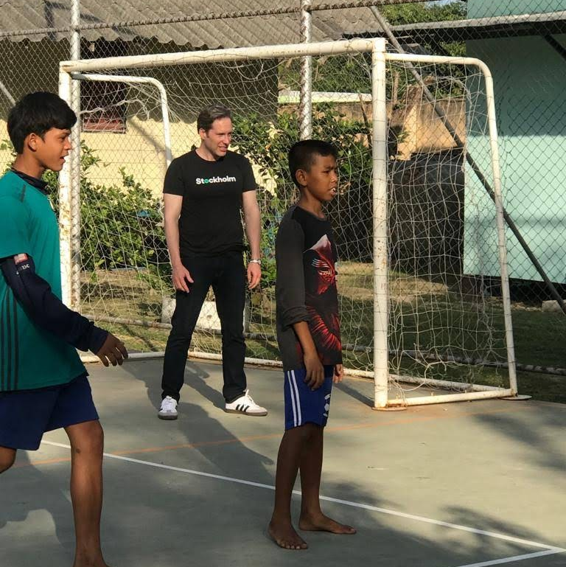

Hi, I am Jim
Notes:
Hi, I am Jim
------------
I lead Infrastructure and Operations (IO for short) at Spotify
IO is the core infrastructure part of our Platform Mission at Spotify
The job of Platform is to enable all of the engineers to scale at speed, safely
Everyday we get up and think about ways we can be an amplifier
for innovation at Spotify

Slide 3

The Spotify Story:
Moving from DIY to an Active Community Member
Notes:
Today I am going to talk about
How to move from a NIH & DIY infrastructure provider
to a (More) Active Community Member
This is a talk about strategy and what we call "ways of working"
It is about how we have shifted teams:
our infrastructure teams and how we work with many others
in complex, large-scale environments
With lots of existing traffic and interdependencies

Slide 4
Why?
Notes:
So why am I doing this?
We know lots of companies are facing similar challenges
We often receive help from this community
We try to help as well by sharing our lessons learned
It is my hope that this will help people who are wrestling with how to move from
Internally-focused technology and ways of working to
benefiting more from the community

Slide 5

A Caveat...
Notes:
First a Caveat
We are still on our Journey
We have not found all the answers
However, our teams have learned some very useful lessons
We want to share these because we are all in the infrastructure space together
...and we hope to talk more with all of you and learn more while we are here this week

Slide 6
So let’s get started

Slide 7
Spotify 💚 Infrastructure
Very early adopter of modern infrastructure and practices
Microservice user for a decade
Now pursuing things like micro-features
Long-time practitioner of autonomous teams, rapid-release, operations in squads (devops), and more
Notes:
First, a little more about us...
We love good infrastructure at Spotify. It is at the heart of our technology
We were an early adopter of modern infrastructure practices
Nearly a decade ago, we adopted microservices and containers.
Many people joined us years ago for this reason
And, as you may have see in our videos, we were already adopted agile practices
like micro-releases, operations in squads, and more

Slide 8
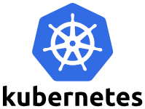





But, we built most of this ourselves
We built Alien
We built Hermes
We have Helios
We have Celo
See Apollo
We created Heroic
Notes:
But, we were so early that we built much of our infrastructure technology ourselves,
before CNCF was formed --- or had grown past it’s starting set of products
(That's how ingrained infra is into our DNA)
Here is just SOME of what we have:
Helios -> k8s
Hermes -> gRPC
Alien -> Grafana
Apollo -> Spring
Celo -> Vault
Heroic -> Prometheus
You can find these on Github under the Spotify public organisation.
We also have the very popular Luigi project there
It is our most popular open source project (with over 11,500 stars) created by Spotify’s Data Infrastructure organisation
Ironically, we open-sourced the Helios (which we were already using at scale in production)
the same week Kubernetes was opened

Slide 9
We run our infrastructure at scale
Already public
Over 200 million monthly active users
Over 2500 microservices
Over 8 million QPS at our perimeter
Billions of captured events per hour
Hundreds of deployments per day
222 open projects at github.com/spotify
TL;DR: Lots of scale moving at high speed
Notes:
And we have have been using these, and other infrastructure technologies, at scale
--for years, through rapid growth
Here are some numbers to show how much we move with infra on a daily basis
- Over 2500 microservices
- Hundreds of deployments per day
- Over 200 million MAUs
- Over 8 million QPS at the perimeter
- Capture billions of events per hour
- We have 22 open projects on Github, the most popular of which is Luigi, from Spotify’s Data Infrastructure tribe
(BTW, none of these numbers are new. You will find them in presentations from 2018 or early 2019):

Slide 10
So why do we want to change anything?
Notes:
So, we have been successful at using our infrastructure at scale for a while
All of this works
We move quickly (over a thousand deploys a day)
We keep the music streaming and our business is growing
Why the heck do we want to change anything???

Slide 11
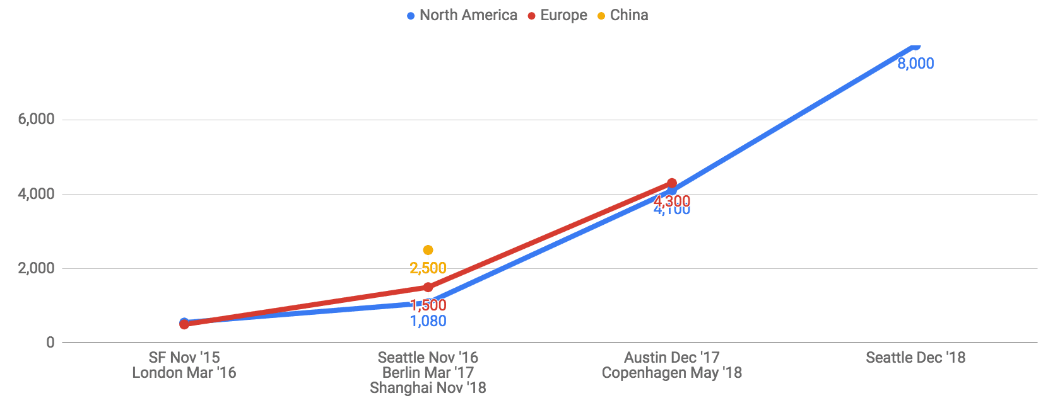
The Power of Community
Notes:
The answer is simple: Communities have power, and by joining a community that is organically growing on its own, we can benefit from the speed and volume of innovations coming out of open source projects.
This graph represents many things:
Not just the attendees at conferences like this
But the growth of communities like CNCF over the past four years
More importantly, the growth in contributors of open source infrastructure

Slide 12
Staying at the forefront, wisely
Opportunity Zone
Source: “Innovator’s Dilemma” - Clayton Christensen
Notes:
At Spotify, we strive to stay at the forefront for our infrastructure and developer experience because despite the fact that we are a well established brand, we still have to stay ahead of the competition and infrastructure is foundational to building better technology and products
There is no way we could hire a team big enough to outpace the entire community
It would not even be the right thing to do
It would not be inclusive.
It would not be a wise use of our resources
It would create a larger learning curve for everyone who joins us
By joining the community, we tap innovation, use our resources better,
and make it easier for others to join and work with us
It would be easy to keep adding features to Hermes or Helios.
But we are an the “Opportunity Zone”
We know that shifting to more open technology is the right thing to do:
for our developers, our company, and our customers
The trick is doing this--without sacrificing speed, scale, risk, etc.

Slide 13
Our Vision
World-class infrastructure
Spotify “Special Sauce”
Unleashed innovation across unlocked teams
Notes:
In a nutshell, here is our vision
Our infrastructure teams aspire to do this by starting from world-class infrastructure
We then want to work to improve this to support challenges we see from the scale of Spotify and complexities of our business
And adding our tooling and technology to enable our engineers to use this quickly and safely
This will unlock our engineering teams, enabling them to innovate faster

Slide 14
Our Journey
Notes:
So now, I would like to take you on a rapid review of our journey
How did we start?
What worked?
What problems did we hit?
What did we learn?
And what do we hope to do next

Slide 15

How we initially viewed our journey
Origin (DIY)
Destination (CNCF, FOSS)
Notes:
When we started, we viewed our journey as a point-to-point journey
We “knew” where we wanted to go
After we made our decision, we put some steps in motion to get going...

Slide 16
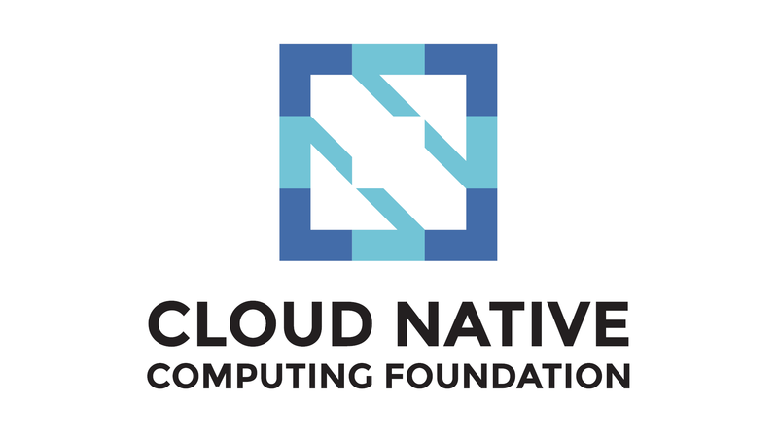


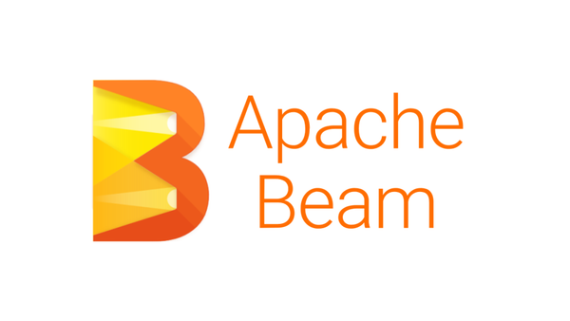

We joined many communities
Notes:
We joined many communities. Here are some examples
We just joined CNCF last year (we also up-leveled our involvement in the Python community)
We have ambassadors and core contributors in all of these communities
This is from all across Spotify’s Platform teams: core infrastructure, data infrastructure, ML and more

Slide 17
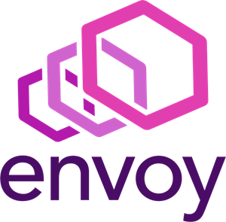


We began to work on these technologies in earnest
Notes:
We began to explore many technologies in earnest
What new things to we get? What do we need? How do we migrate to them?
We looked at the pure CNCF projects and versions of these from managed service providers

Slide 18
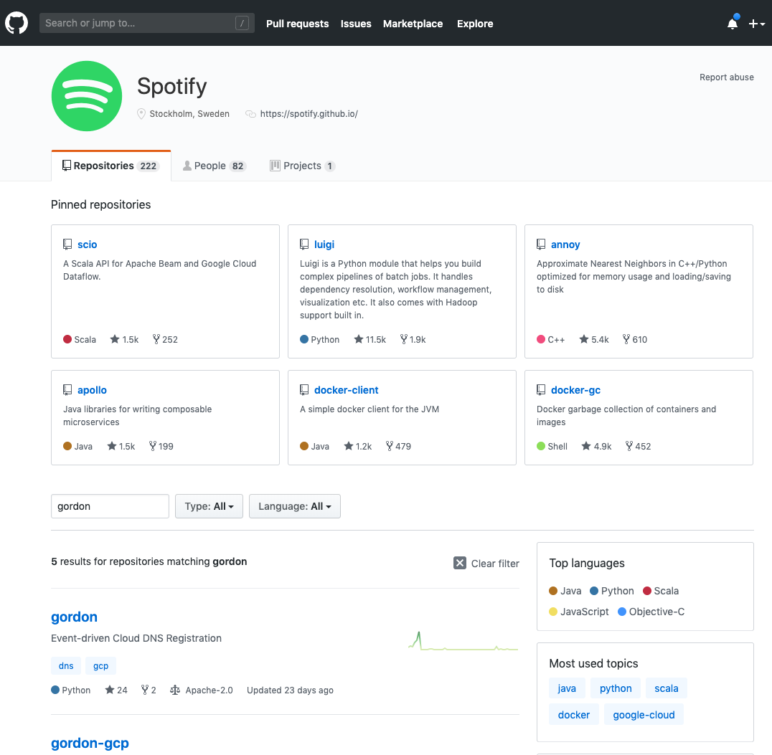
We even began to build some things completely in the open
Notes:
We already had many open projects
We started actually building some completely in the open (instead of opening them post-MVP)

Slide 19
At first, things started off really well...

Slide 20

People were excited, not afraid
Notes:
One concern was whether we would lose something special by moving away from our own infra
and whether this would make our teams feel like they were losing something
The opposite was true
People were excited.
They were learning something new and able to leverage our battle-scars to improve infra for all
No one left because of this.
In fact, people joined because of it

Slide 21

Just exploring begins to change culture
Notes:
We also learned that just even starting with an open mindset
Looking at what others were doing
Changed our culture
We became more open to re-thinking challenges and assumptions
As one tangible example: we began to architect for ephemerality
in more and more places across our company
This was an great, enriching development

Slide 22

The community is very generous
Notes:
And, as we spoke about last year, we were amazed by the generosity and knowledge sharing
So many of you shared ideas with us
Thank you.
I want to take a moment to give a big “shout out”
to Alexis Richardson and Matt Klein who have been so generous
CNCF is a community of awesome people

Slide 23
So, everything was rosy, huh?

Slide 24

Not exactly
Notes:
Not exactly.
Once we got in deeper to things we hit a brick will, several in fact

Slide 25
Some big things we learned
Notes:
Here is what we hit and some of the big things we learned...

Slide 26
Plugging things into your ecosystem is really hard

Slide 27

CNCF Community
Our Providers’ Landscape
Our Tech Landscape
Notes:
Like many, we have lots of technical use cases
That creates many edge conditions
We also are a public company, with 200+ million users
We have to ensure speed, uptime, compliance, security, etc.
(click) As good as a project is, just grabbing it off the shelf is just the start
In the reality, we have to get it to work with our cloud provider (click)
and with the rest of our ecosystem (click)
I can walk you thought one simple example for k8s
VPC, infra for capturing events, compliance, etc.
It would have been actually easier and faster for us to keep adding features to Helios
But we knew that getting on the k8s train was the better long-term bet
This took a lot of time, but it was an example of real-life in that “Opportunity zone” I spoke about earlier

Slide 28
Migration is a Four-letter Word
Notes:
Then there was migration
Migration is a four-letter word
I have a few slides on why...

Slide 29
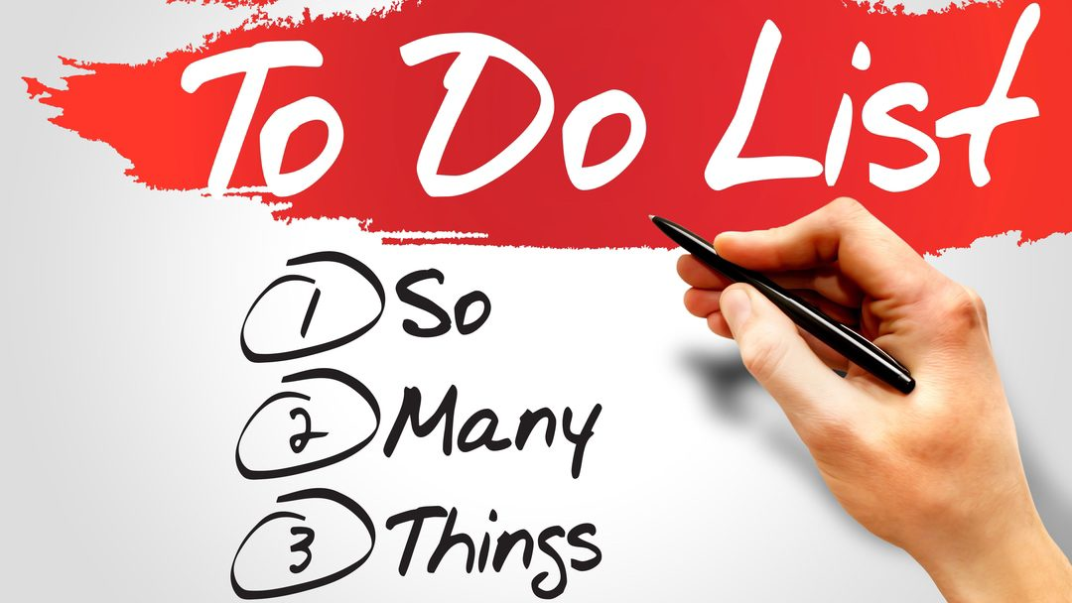
Notes:
Teams are busy
We all have LOTs of priorities.
Migrating to something just because it is a better technology
Or just because it is better for the infra teams is NOT enough
Our customers simply did not have time

Slide 30

Notes:
People wanted to know why
We need to explain why this is good for our customers
(and work to ensure it IS really good for them)
Taking Kubernetes as an example, we had to explain
Why K8s and not serverless-as-a-service
And not cloud-provider-X’s application-engine-as-a-service
Without that story, our customer’s business and product leaders often prioritise other work

Slide 31

It’s not the changing the engine mid-flight
That is too simple
Notes:
And, when you are big, making a change is not binary
In the infrastructure field, we like to use the analogy of changing and airplane engine in mid-flight
But that analogy is too simple
It implies there is just one plane and one flight crew...

Slide 32

It is coordinating MANY moving people
Notes:
In reality many teams are changing many engines mid-flight
We needed to coordinate our message across these teams
AND we needed to coordinate our messaging with other infrastructure teams who wanted changes
At first, we did not do this well enough. And we hit a big wall.

Slide 33

Building in the open takes time and training
Notes:
Finally, building in the open takes time to learn
It takes practice.
At first, it is slower and scarier.
Just as you would not run a marathon after one training session
Jumping into the open was slower than building internally first.
So...

Slide 34
All of this was confounding

Slide 35
Is it just too hard?
Notes:
Plugging all of this into you ecosystem is hard
Grabbing off the shelf did not work for us
Reality of: OPen + Provider + Local Ecosystem
Dev Experience not as good
It was actually easier and faster for us to add somethign small to Helios
Then

Slide 36
Do we give up? What should we do next?
?

Slide 37
Then the answer came from our teams...
From our community

Slide 38

Notes:
For many years, we have used a model known as embedding,
where a specialist joins another team to provide specialised knowledge to help
Our teams started to reverse this model
They invited our customers to temporarily join our teams and BUIlD WITH US
It provides us great knowledge of how to solve the problems they have
It gives them the confidence that their problems are solved
We retain the result as infra we maintain and manage
It also solves big parts of the busy-ness problem:
We can do more together than we can alone
and if something is important enough, we will find ways to partner
We do not have to predict the future alone--we do so together
That ensures we are focus on the places that provide the biggest benefit to Spotify
This lead to an important learning...

Slide 39
We needed to be open internally first
Origin (DIY)
Waypoint (Building With Others)
Destination (CNCF, FOSS)
Notes:
The path to open community started with being more open internally first
This allowed us to develop these new muscles in a safer environment
It also allowed us to get more tangible results for Spotify, in less time...

Slide 40
The results look like community growth
Adoption
Time
Notes:
The results were pretty amazing
We started to see adoption of infrastructure pick up and grow rapidly
The biggest driver was shared success stories
One customer would share benefits of the engagement and adoption
And others would follow
We began to see this in waves as we adopted different infrastructure items and technologies
This validated two things
- Community works
- Empowering teams to act drives more than directing teams to act

Slide 41
So we adopted this as a purposeful strategy
Notes:
Plugging all of this into you ecosystem is hard
Grabbing off the shelf did not work for us
Reality of: OPen + Provider + Local Ecosystem
Dev Experience not as good
It was actually easier and faster for us to add somethign small to Helios
Then

Slide 42

Build Infrastructure Together
Build on others
FOSS
CNCF and others
Cloud providers
Build with others
Reverse Embedding
Partnerships
Hackathons
Build on us
Platformisation
Innersource
Build in the Open
Notes:
So this lead us to adopt this as a formal infrastructure strategy...
(We call it) Building Infrastructure Together
Specifically we will build infrastructure together in three ways:
Build ON OTHERS. Rather than inventing things that already exist, we will look to our cloud-native partners and the FOSS community first. Specifically, we will use our leverage and expertise to improve these technologies, driving their roadmaps and directly making contributions.
Build WITH OTHERS. Rather than build our infrastructure in isolation, we will build as much as possible together with our customers across Spotify. To do this we will apply practices like office hours, mob programming, tribe advocates, and reverse embedding to partner with our customers to combine their domain expertise with ours. This will ensure our customer’s needs are met faster and that Spotify’s infrastructure is less fragmented.
Build ON US. We open our infrastructure to all of Spotify (think “inner source”) empowering customers to extend out tech more rapidly to meet their needs. We will purposely serve as custodians of Spotify’s infrastructure, adopting FOSS-style guidelines and governance that makes it easier for others to modularly contribute to our tech. Where appropriate, we will even open source our technology to gain benefits from the wider infrastructure industry and community.
This is not just shared development. It is shared product marketing, communications, and change
We have now invested in platform product marketing
We work with our customers to agree to what is important
We coordinate when to understand what changes bring the biggest benefits first
We work together to make these changes
This is new for us -- less than 180 days old -- but we are seeing lots of great traction

Slide 43

But we still had one nagging doubt
Notes:
But we still had one nagging doubt
How do we KNOW where to invest?
How do we select the right projects to invest in?
How do we avoid risking missing out on a key development?

Slide 44
The we realised that we needed a different POV
Notes:
We actually ALREADY had the answer in our strategy

Slide 45

Start (DIY)
Destination (CNCF/FOSS)
Notes:
We first thought we were on a journey from DIY to broadly adopting CNCF and other open source

Slide 46
Start (DIY)
Waypoint (Build Together)
Destination (CNCF/FOSS)
Notes:
We got stuck and found building infrastructure together was a great waypoint for us
We could rest, re-focus, and re-fuel

Slide 47
Many Futures
Start (DIY)
Destination (Build Together)
Notes:
But then we realised the Building Infra Together IS the Destination
We do not need to predict the future. Or invest to heavily we can out-infrastructure everyone
By building on others--like all of you--we can take advantage of your innovation and add what we need to give Spotify competitive advantages based on our needs
By building with others--you and our internal customers--we can stay in touch with emerging needs and stay very relevant. We can leverage each other’s expertise to be greater than the sum of our parts
By letting other build on us we can let them amplify our work, benefiting from the innovation of all communities (Spotify’s internal and the open CNCF community), for free
Build with communities is our new destination

Slide 48
What’s Next For Us -- and you(?)
Increase our involvement in CNCF and FOSS projects
Do more in the open
Formalise some work to build with others
Long-term aspiration: Our own top-level projects
Notes:
So as a mentioned at the start, we are still one the first parts of our journey. Year 2 of it, if fact
We are inspired by many others. For example
Lyft has a growing consumer business and developed Envoy
Shopify also has a growing consumer business and has over 500 open source projects
Here is what is next for us:
We want to increase our involvement in open projects, especially making more direct code contributions
We want to do more in the open. We have doubled our work in this over the last year
We want to formalise some arrangements to build more with many of you
Instead of waiting for Company X to do something
Let’s work together so “You and Spotify can build and advance the next version of [Your favourite project here]
Long-term we aspire to have a few top-level projects.
We are working with others to help find things that make sense, in terms of need and work
We do have some ideas thanks to input from some of you

Slide 49
Want to learn more?
See this in action with Austin & Dave’s talk tomorrow or checkout Matthias’ talk online (if you missed it)
Build infra with us -- or let us build with you
Join our NEW speaker series and share your ideas
Or “join The Band” - we are hiring

Slide 50
Thank you!
Find me here:
jhaughwout@spotify.com
https://twitter.com/jhaughwout
https://www.linkedin.com/in/haughwout/

